Slide 1
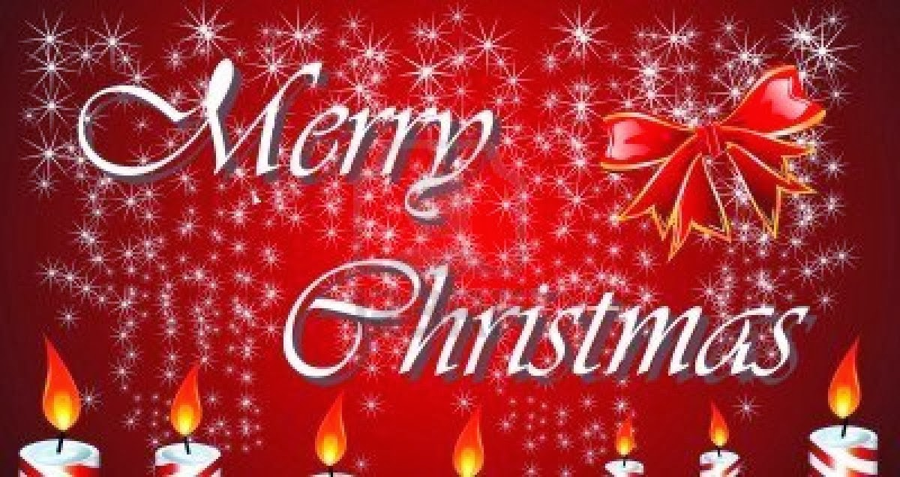

Slide 2
Christmas EVE
Christmas Eve is traditionally the day for decorating churches and homes. It marks the beginning of the period formally known as Christmas-Tide.

Slide 3
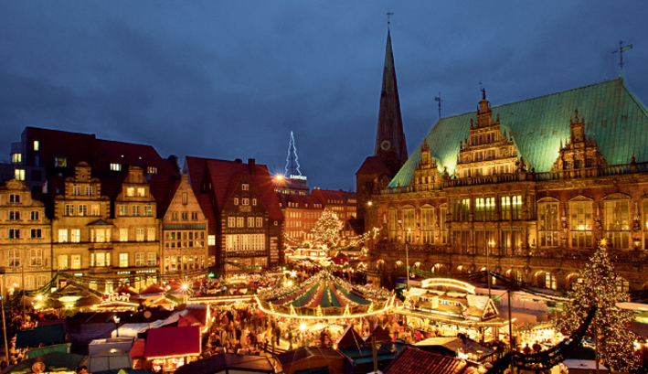
CHRISTMAS IN ENGLAND
In England families often celebrate together
Most of them have a Christmas tree in their house.
Most villages, towns and cities are decorated with lights.

Slide 4
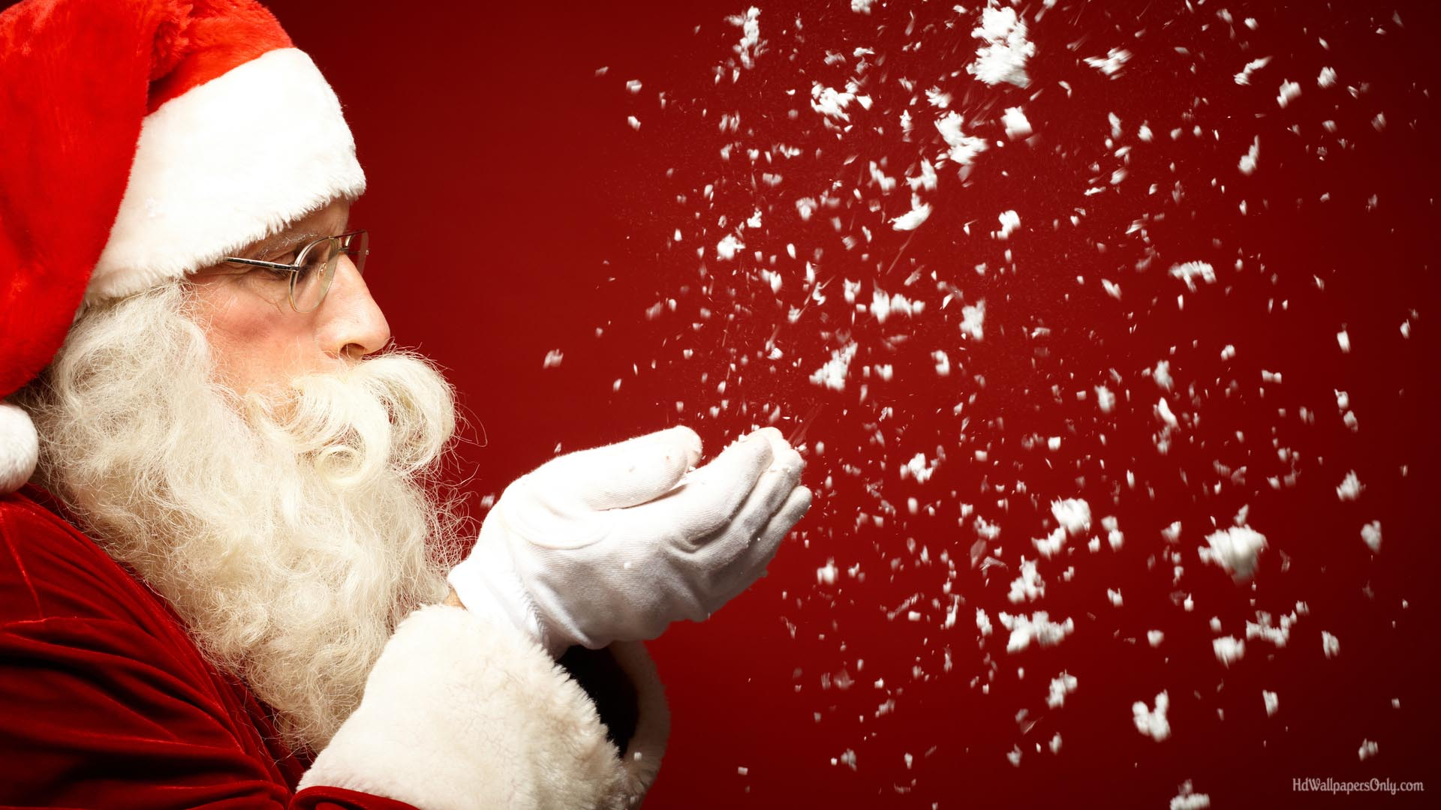
SANTA CLAUS
Children believe that Father Christmas or Santa
Claus leaves presents in stockings or pillow-cases.
These are normally hung up by the fire or by the
Children’s beds on Christmas Eve.

Slide 5
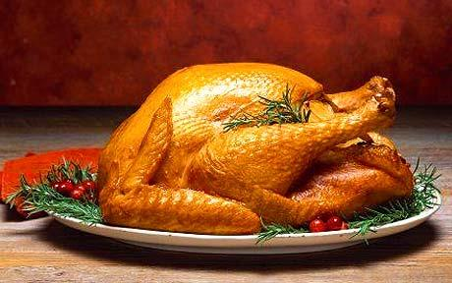
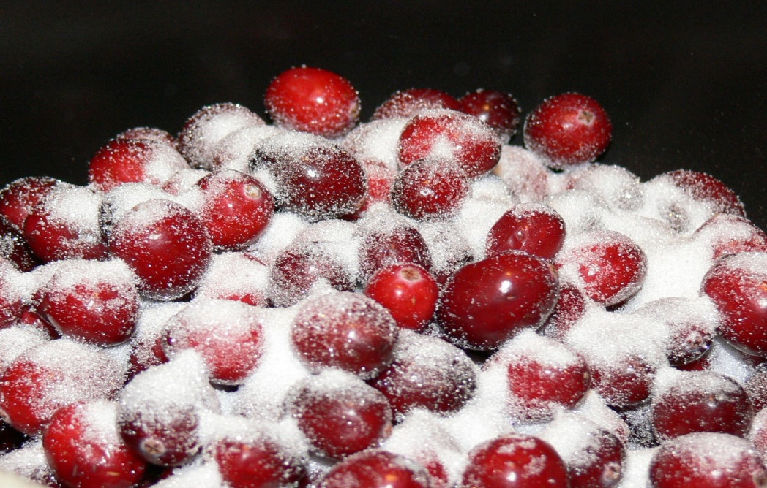
TRADITIONAL FOOD
A Traditional
English dinner includes:
Roast turkey or goose
Brussels sprouts
Cranberry sauce
Roast potatoes etc.

Slide 6
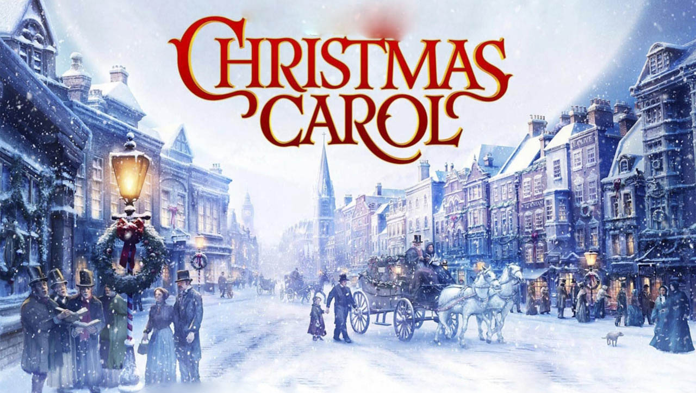

Slide 7
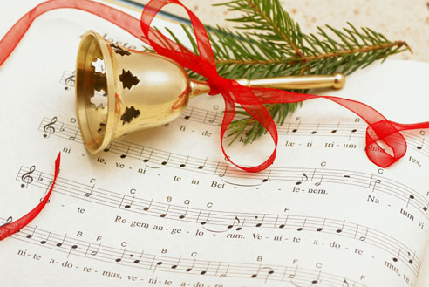
Christmas carols are special songs which are
Sung during the Christmas season.
The songs are about Jesus and the time
When he was born..
Children sing carols in the streets or public
Places.
They collect money for charity.
The traditional period to sing carols is from
Saint Thomas’s Day until the morning of
Christmas Day.

Slide 8
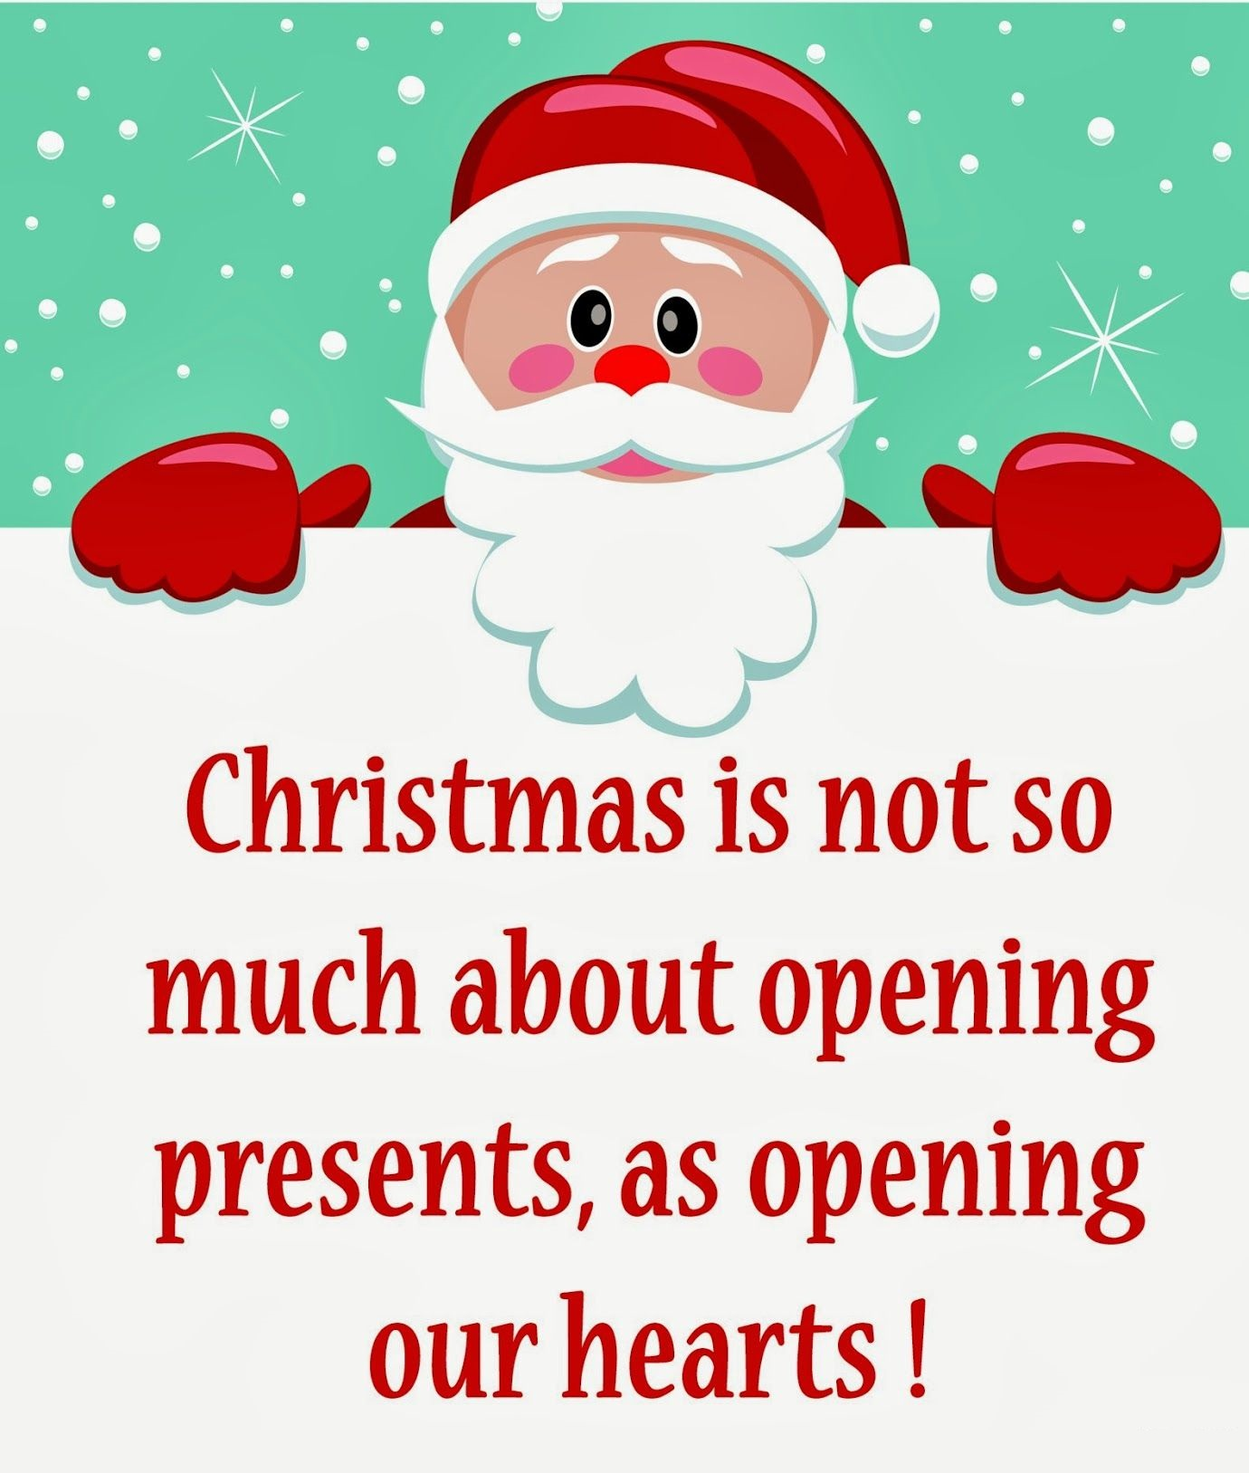
‘’THE END’’
By Nicky Zoubaki

