Slide 1
Christmas time!
Χρήστος Γεωργόπουλος
Γ1΄
4^{ο} γυμνάσιο πύργου 2015-16

Slide 2
Christmas in Greece
People in Greece celebrate Christmas on the 25th of December . They celebrate the birth of Jesus
He was born in a manger with lots of animals because his mother and father couldn’t find a warm place because all was full of…!

Slide 3
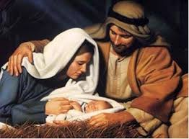
The place …!

Slide 4
People.
Nowadays people decorate trees with lots of lights, balls and on the top of the tree they put a big star which is the symbol of christmas!!
They make every year traditional sweets such as melomakarona, kourampiedes and diples
On 24th December children sing carols from door to door and people give whatever they want…

Slide 5
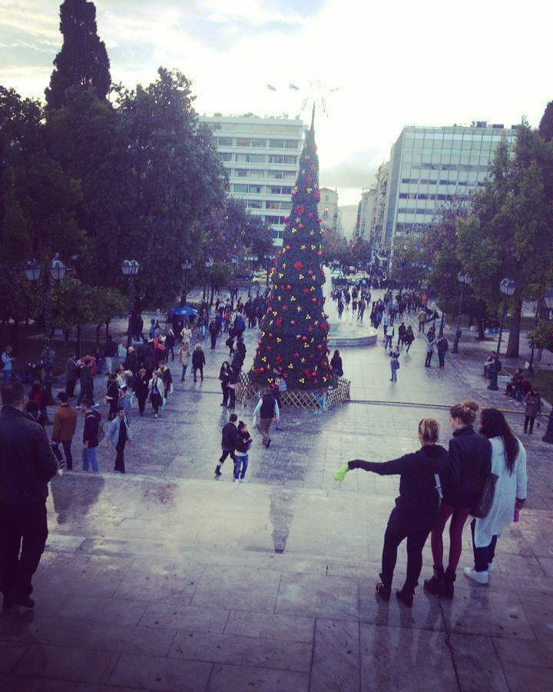
The tree is decorated…!!!

Slide 6
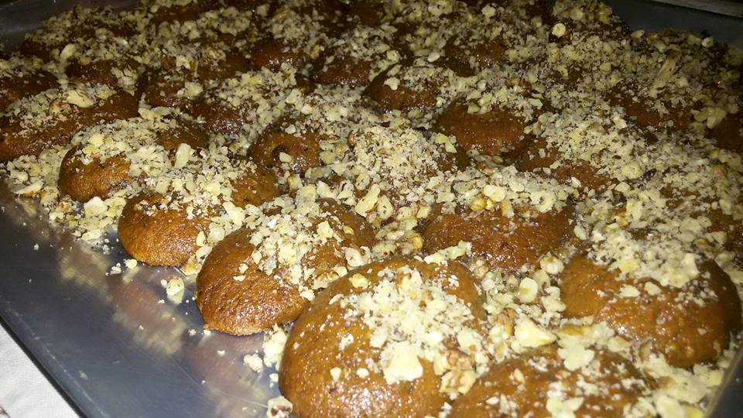
Melomakarona

Slide 7
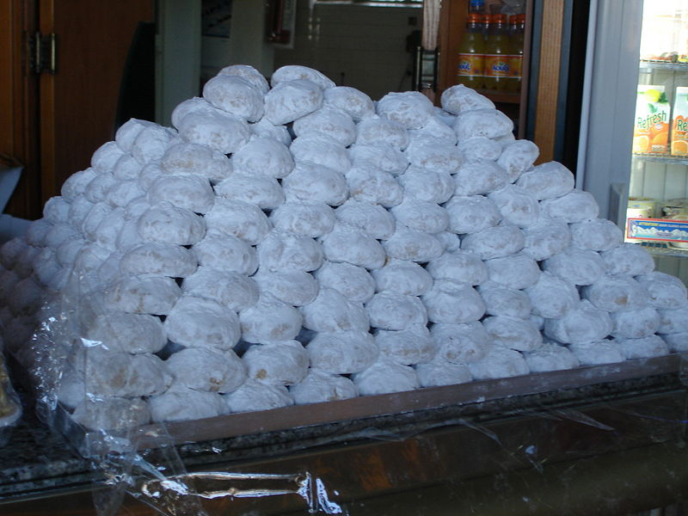
Kourampeides

Slide 8
People every year get together, they sing laugh in front of the tree with their families the set fire because it’s winter and snows and all together they spend this celebration !!

Slide 9
END
Information:
Google
Youtube
Wikipiedia

