Slide 1
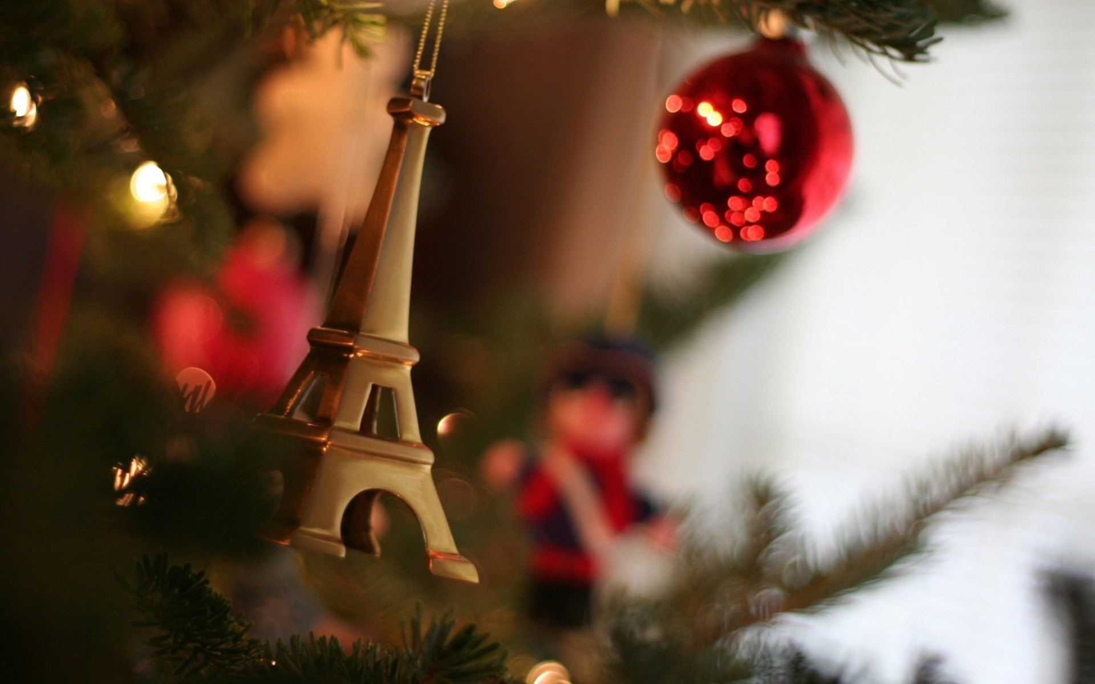
Christmas in
France

Slide 2

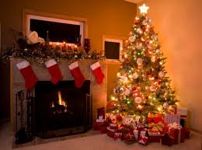
The decoration
As in most Western countries, the typical tradition involves a decorated Christmas tree, under which Santa will place the presents.

Slide 3

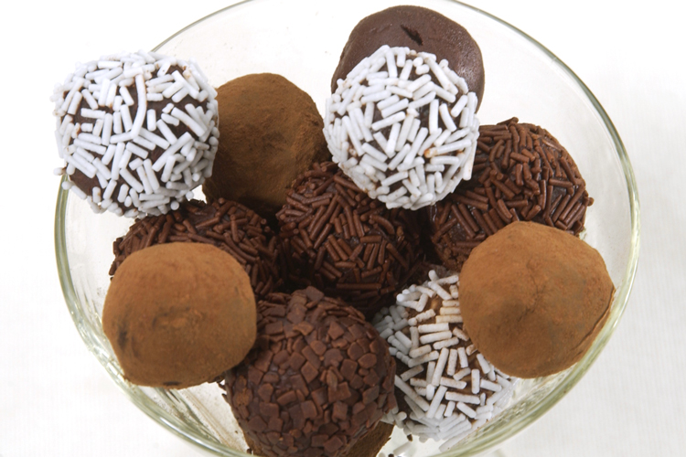
CHRISTMAS FOOD
A fair amount of chocolate is involved of course, especially chocolate truffles and, for the children, Santa's chocolate .

Slide 4

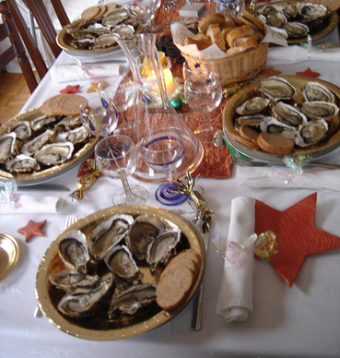
Βefore the main course you go to oysters. Your oysters will probably be eaten with a dry white wine, e.g. Alsace wine.

Slide 5
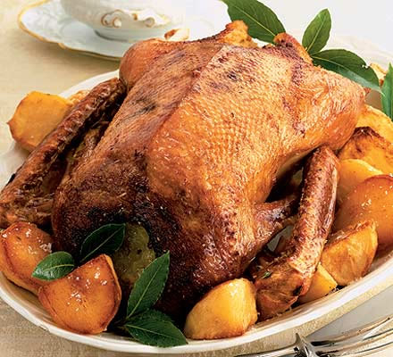
Then for the main course, the traditional dish would be turkey with chestnuts, or things like deer or another type of game meat, possibly even duck, probably accompanied with some kind of potatoes (most likely pommes dauphines). The main course is accompanied with red wine and of course cheese.

Slide 6
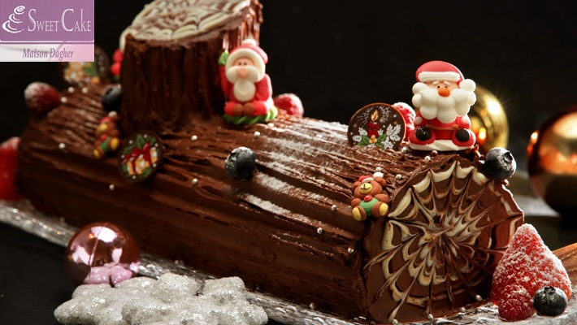
The typical dessert would then be a bûche de Noël, which is a traditional French Christmas cake in the shape of a log. At this point of course, you drink lots of champagne!

Slide 7
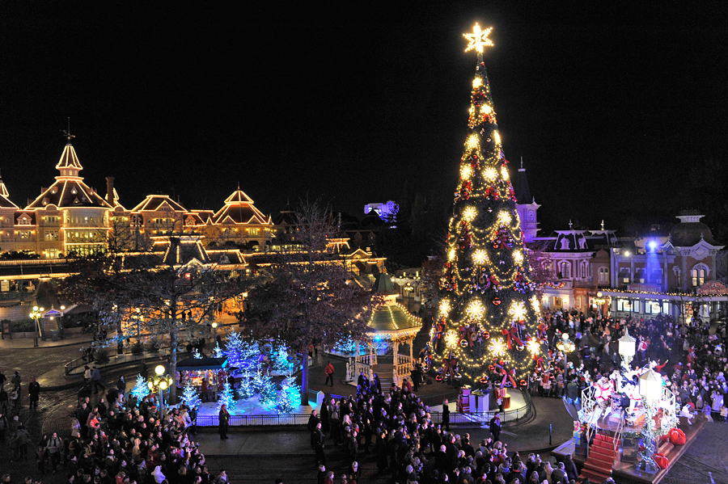
CHRISTMAS DAY
Public life on Christmas Day is generally very quiet. Post offices, banks, stores, restaurants, cafes and other businesses are closed. However, some stores at airports, railway stations and major highways, may be open. Many people spend Christmas Day quietly and some attend a special church service. Popular activities also include walking in a park or the countryside and sharing a meal with family and close friends. Many churches display a crib scene, often with life-size figures representing Mary, Joseph, Jesus and other characters from the Nativity, during this time of the year. Some churches even include actors and live animals.

Slide 8
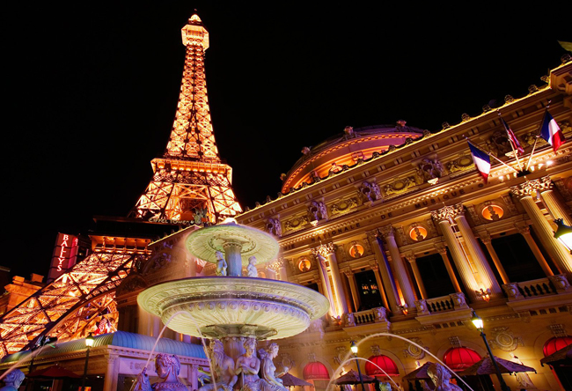
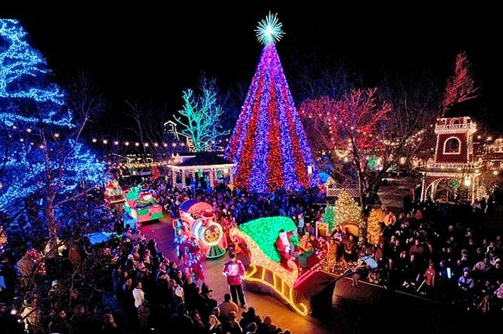
Paris is often nicknamed the City of Light: This is more true than ever during December , around the Christmas celebrations.

Slide 9
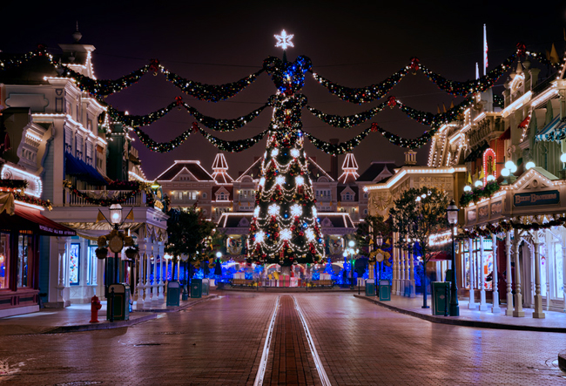

Slide 10
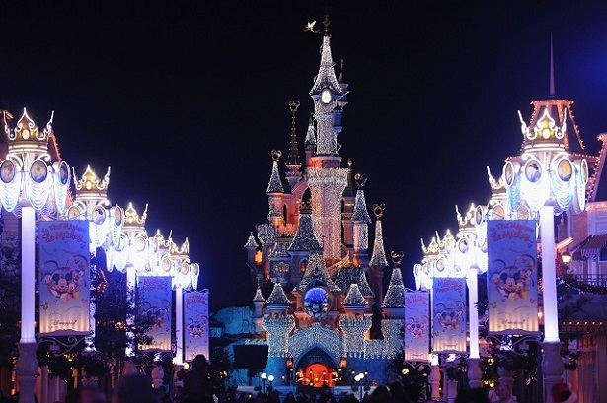

Slide 11
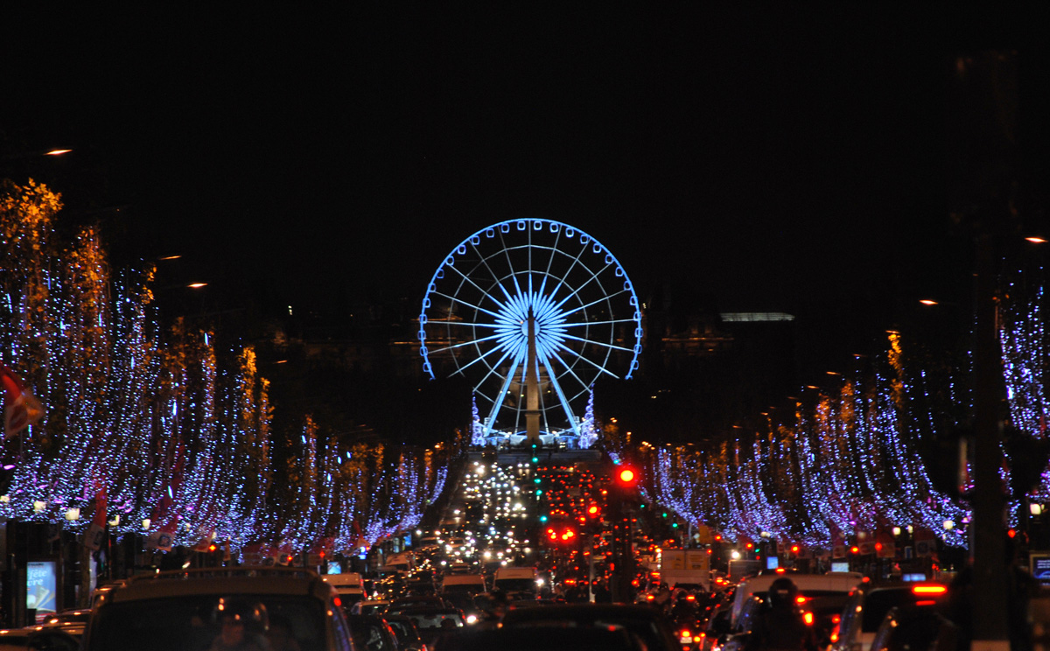

Slide 12
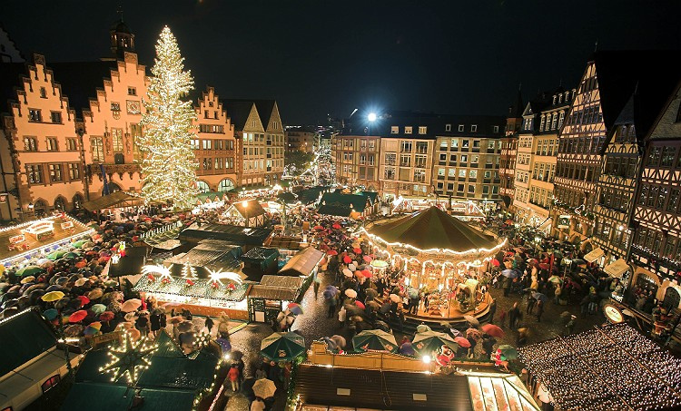

Slide 13
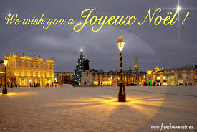
Mary Georgopoulou

