Slide 1
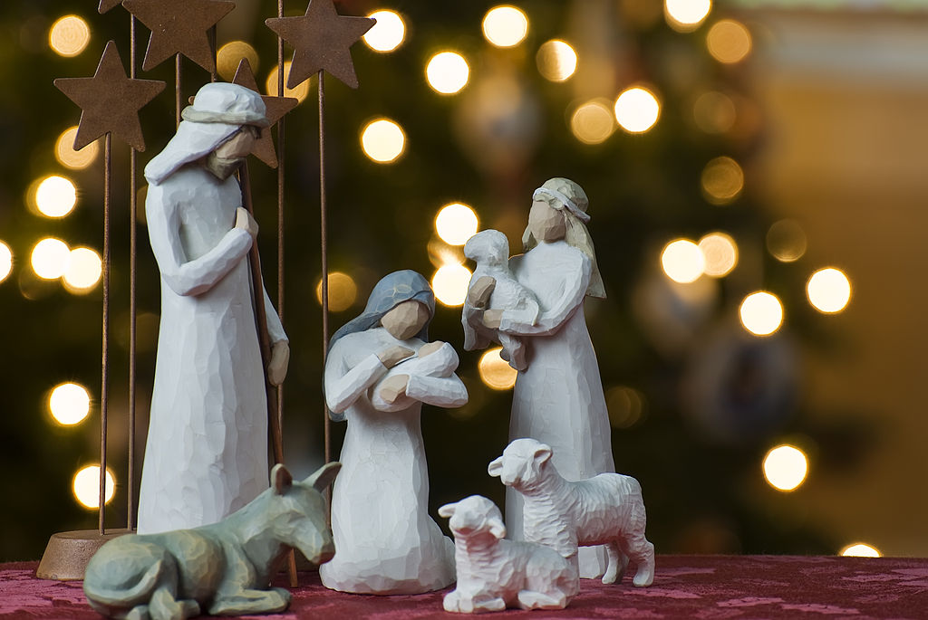
Christmas Day

Slide 2
Christmas Day, on December 25, is one of the most festive Christian holidays in many countries around the world. It celebrates Jesus' birth.

Slide 3
How do we celebrate the Christmas day?
Christmas Day is a holiday in many, but not all, countries. Many homes have Christmas trees and other decorations in the weeks leading to Christmas Day. Some workplaces hold Christmas parties prior to December 25. Festive activities include exchanging presents, singing Christmas songs, going to parties.
It's a special time when children get presents from family, friends and Santa Claus, or Father Christmas. For some, Christmas is an exclusive family affair, while others invite friends to a Christmas buffet or pot luck meal. Churches have special services and may include a crèche or miniature Nativity scene.

Slide 4
Traditional cuisine
A special Christmas family meal is traditionally an important part of the holiday's celebration, and the food that is served varies greatly from country to country. Some regions, such as Sicily, have special meals for Christmas Eve, when 12 kinds of fish are served. In the United Kingdom and countries influenced by its traditions, a standard Christmas meal includes turkey, goose or other large bird, gravy, potatoes, vegetables, sometimes bread and cider. Special desserts are also prepared, such as Christmas pudding, mince pies, fruit cake and Yule log.

Slide 5
Music and carols
The songs we know specifically as carols were originally communal folk songs sung during celebrations such as "harvest tide" as well as Christmas. It was only later that carols began to be sung in church. Traditionally, carols have often been based on medieval chord patterns, and it is this that gives them their uniquely characteristic musical sound. Some carols like "Personent hodie", "Good King Wenceslas", and "The Holly and the Ivy" can be traced directly back to the Middle Ages.
Completely secular Christmas seasonal songs emerged in the late 18th century. "Deck The Halls" dates from 1784, and the American "Jingle Bells" was copyrighted in 1857. In the 19th and 20th century, African American spirituals and songs about Christmas, based in their tradition of spirituals, became more widely known.

Slide 6
Thank you!! Name: John Surname: Mastrogiannopoulos Class:Γ’3

